Slide 1







Loyalty Program
a Worldcoin-powered App for a private members club with a loyalty program

Slide 2
Loyalty Program team
Anna Kolbasova - kolbasova78@aol.com (Team Leader)
Free-lance Front-end and Blockchain Developer (Solidity, Rust, Solana, JavaScript, Typescript)
Charles Okochu – ocobra@gmail.com
Cloud Architect and Project manager (AWS, Google Cloud, Python, javascript)

Slide 3
What is Loyalty Program?
A Worldcoin-powered app for a private members club allows members to pay in crypto on a multi-blockchain platform and use Decentralized Identity (DiD) to earn loyalty benefits and level up. Members can also receive benefits from partner companies that accept the World App. Covalent will help create a ledger of transactions from any blockchain address wallet.
Notes:
This application would allow the club to track customer spending and behavior in a way that is both transparent and secure. The club would be able to see how much money each customer spends on drinks, food, and other services, as well as how often they visit the club. This information would help the club to understand what its customers want and need, and to make sure that they are providing a positive and enjoyable experience.
The application would also allow the club to offer different membership levels based on customer spending. Customers who spend more money at the club would be eligible for higher membership levels, which would come with exclusive benefits, such as free drinks, priority seating, and access to special events. This would incentivize customers to spend more money at the club, and it would also help the club to better segment its customers and target them with marketing messages.
In addition to the benefits that customers would receive from the club, they would also receive benefits from partner companies that accept the World App. These partner companies could offer discounts, free products or services, or other exclusive benefits to World App users. This would make the World App a more valuable tool for customers, and it would also help to promote the club to a wider audience.

Slide 4
How To Use Loyalty Program
One-time Registration
At the entrance, security will check how the customer scans the QR code with the Worldcoin app. The QR code will have a connection with the Member Club app.
Customers can pay in Digital Dollars using their Wallet. Every transaction will be converted to ETH on a smart contract using an oracle like Chainlink.
The smart contract is deployed on Optimism, Base, and Zora blockchains. Customers can also pay using the Worldcoin App.
Covalent will help create a ledger of transactions for the App.
Customers who spend more than \$1,000 will be upgraded to associate membership. Spend \$5,000 for bronze, \$10,000 for silver, \$15,000 for gold, and \$25,000 for platinum. Each level offers different benefits.
Notes:
At the entrance, security will check how the customer scans the QR code with the Worldcoin app. The QR code will have a connection with the Member Club app.
If the customer is visiting for the first time, security will need to validate their age and ask for ID. If the customer is over 21 years old, their Worldcoin ID will be added to the club's database and they will be given an account. The user will receive credentials in their World ID. The flagship credential is biometric verification, which is currently available by using the Orb. The user can also verify their phone number to obtain the respective credential. ZKP.
Customers can pay in Digital Dollars using their Wallet. Every transaction will be converted to ETH on a smart contract using an oracle like Chainlink. The smart contract is deployed on Optimism, Base, and Zora blockchains. Customers can also pay using the Worldcoin App.
The account will track the customer's visits to the club, as well as how much money they have spent on drinks, food, and other services.
Customers who spend more than \$1,000 will be upgraded to a higher membership level, such as associate membership. The next levels are bronze after spending more than \$5,000, silver after spending \$10,000, gold after spending \$15,000, and platinum after spending more than \$25,000. Each level has different benefits, not only for this club, but also with partner companies that accept the World App.
The Covalent Explorer will help create an API database with larger transactions for the WorldCoin App
The club will track customer behavior and take action against any customers who engage in aggressive or disruptive behavior. Customers who are aggressive more than three times will be banned from the club.

Slide 5
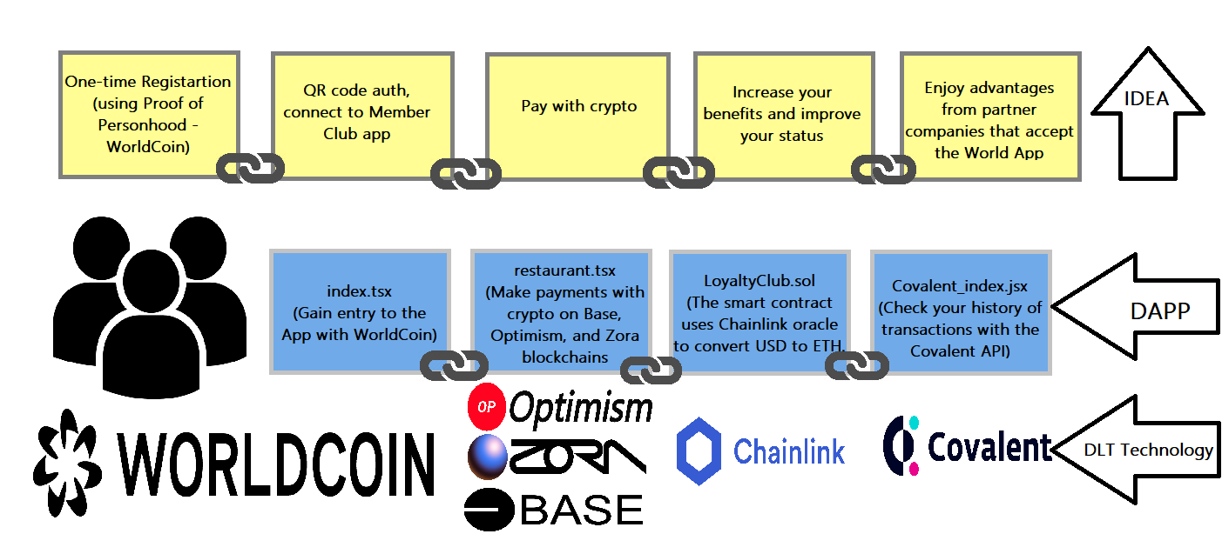
How it works
Notes:
Worldcoin provides Biometric Proof-of-Personhood by ensuring each person can only register once. Similar to biometric identification, the system needs to compare each user’s embedding to every other entry in the database. If none match, the user’s registration is successful and their embedding is added to the database. If there is a match, the user has likely registered before and is therefore rejected.

Slide 6
Customer Value Proposition
Ease and convenience
Pay with Crypto
Quick verification (ZKP)
Earn benefits without revealing your identity
The ability to pay on any blockchain without losing points
It would help the club to better understand its customers and to provide them with a more personalized experience
Notes:
I believe that this application would be a valuable addition to any private club. It would help the club to better understand its customers and to provide them with a more personalized experience.

Slide 7
Additional Resources
Video - https://youtu.be/
Github Repo - https://github.com/annabnn812/member_club

Slide 8
Thank you!
Questions?

